Slide 1
Team B Power Supply
Class: EECT 121-50C
Professor: Andy Bell
By: Dakota Johnson
Josiah Abel

Slide 2
Requirements
Produce a voltage of ±9V with a ±5% tolerance
Carry a maximum current of 100mA
Have an output ripple ≤ 100mV
All linear (no converters)
An input voltage of 120V AC
Maximum start up time less than 100 ms
Must contain a fuse
Maximum cost cannot exceed $25.00

Slide 3
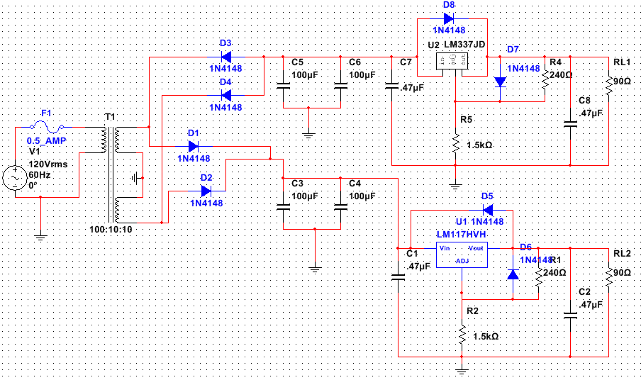
Schematic

Slide 4

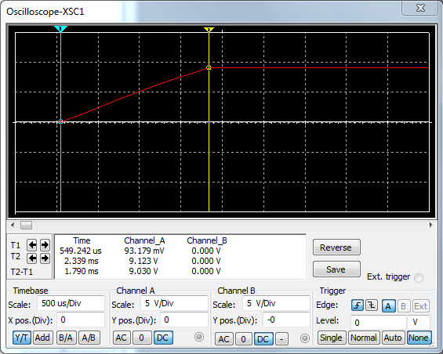
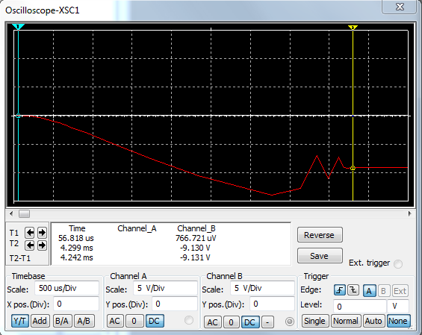
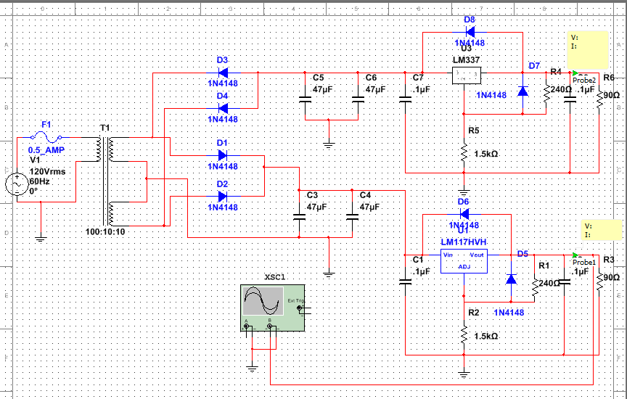

Analysis
Start Up Time +9V
Start Up Time -9V

Slide 5
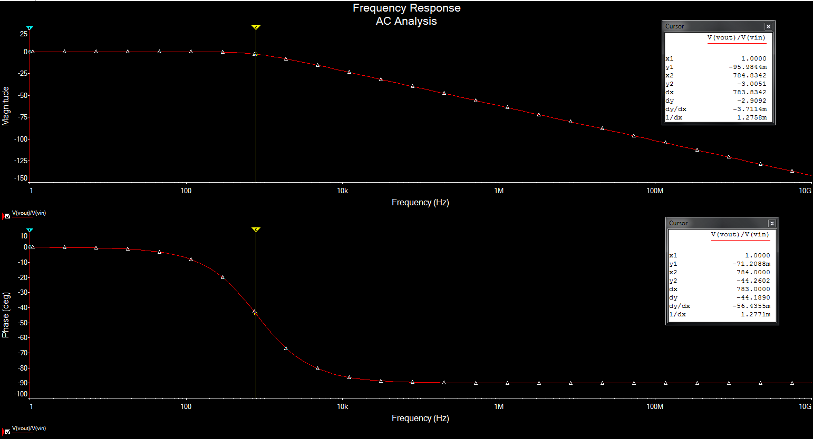
Analysis (Continued)

Slide 6
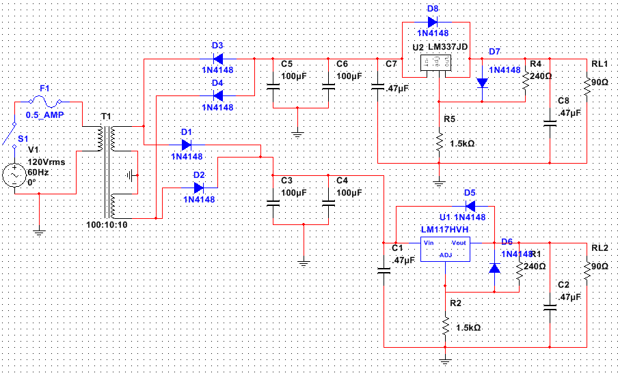
Bill of Material
Item # | Express Part # | Part decription | Quantity | Unit Price | Sub Total
1 | 111N4148 | Switching Diode | 8 | 0.06 | 0.48
2 | 14ER025100U | Electrolytic Radial Lead Capacitors - 100 uf 25V | 4 | 0.19 | 0.76
3 | 14ER050.47U | Electrolytic Radial Lead Capacitors - .47 uf 50V | 4 | 0.15 | 0.6
4 | 13005240 | Carbon Film Resistors 5% 1/4 W - Value 240 | 2 | 0.06 | 0.12
5 | 130051.5K | Carbon Film Resistors 5% 1/4 W - Value 1.5K | 2 | 0.06 | 0.12
6 | 2000MYT1/2 | Slow Blow Fuses Economy Type 1/2 Amp | 1 | 0.5 | 0.5
7 | 2001LINL | In-Line Holder For 1-1- 4 x 1- 4 Fuses | 1 | 0.55 | 0.55
8 | 10317-T | Volt. Regulator Adjustable 1A | 1 | 0.35 | 0.35
9 | 10337-T | Volt. Regulator Adjustable 1A | 1 | 0.75 | 0.75
10 | 16P112-1 | Power Transformer 12.6 VCT 1A | 1 | 6.5 | 6.5
11 | 17SWTOGWR | SPST Toggle Switch with lead wires | 1 | 0.95 | 0.95
1
11
6
7
1
9
4
3
2
5
2
1
10
8
5
4

Slide 7
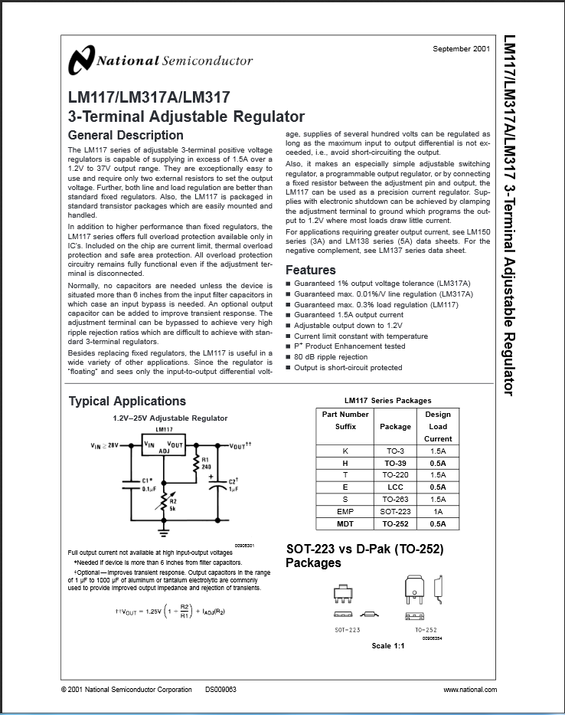
Data Sheets
LM 317
LM 337

